Slide 1

Project Data intelligence application
Pricing and Advertising Strategies
Liguoro Claudio, Mapelli Alessia, Tonazzi Sara
Notes:
We are Alessia Mapelli, Cladudio Liguoro e Sara Tonazzi and we are presenting our soution to the Pricing and Advertising Project

Slide 2







Introduction
General Environment
Liguoro Claudio, Mapelli Alessia, Tonazzi Sara
POLITECNICO DI MILANO 1863
Notes:
Our project focus on the development of an algorithm able to both find the best pricning and advertising strategy for an online movie streaming platform, that supply specialised film prints.

Slide 3
Introduction
Table of content
Context description
Problem set up
Pricing Strategy
Bidding Strategy
Joint Pricing and Bidding Strategy
Context Generation
Liguoro Claudio, Mapelli Alessia, Tonazzi Sara
POLITECNICO DI MILANO 1863
Notes:
We construct our solution step by step strating from smaller problems to get to the general solution. In particular we are going to first focus on the problem description in all its parameters, then we will set up the optimization problem to solve, finding a general solution to it. After we star working on the pricing strategy keeping fixed the bid and all its related parameters and we do the vice versa for the bidding strategy to join them in the end and find a solution to our problem.

Slide 4
Context description
Features Definition
Age
Under 60
Student
Not Student
Over 60
Not Student
Specific Parameters
Specific Parameters
Specific Parameters
Specific stochastic parameters:
Number of daily clicks
Daily cost per click
Conversion rate
Probability of comebacks
Liguoro Claudio, Mapelli Alessia, Tonazzi Sara
POLITECNICO DI MILANO 1863
Notes:
We think our customers can be characterize by two distict fetures, one realted to age that we dicotomize in under or over 60 and one related to profession dicotomized in student or non student. Given this features we can thnk about three main classes of customers: Over 60, Under 60 – not student, and student. This partition is usefull if we want to diversify the prices with specific discounts for example
For each customer class we defined some stocastic parameters that identify their purching habits

Slide 5
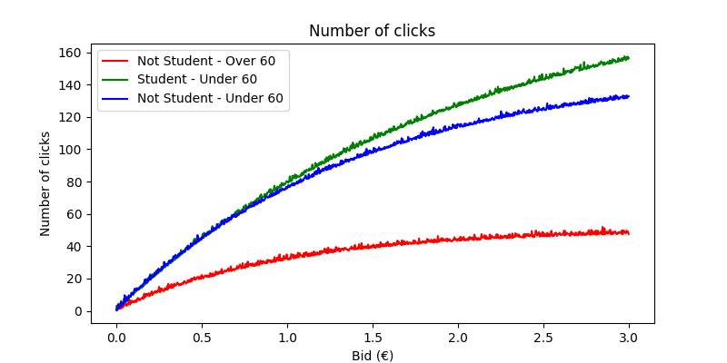
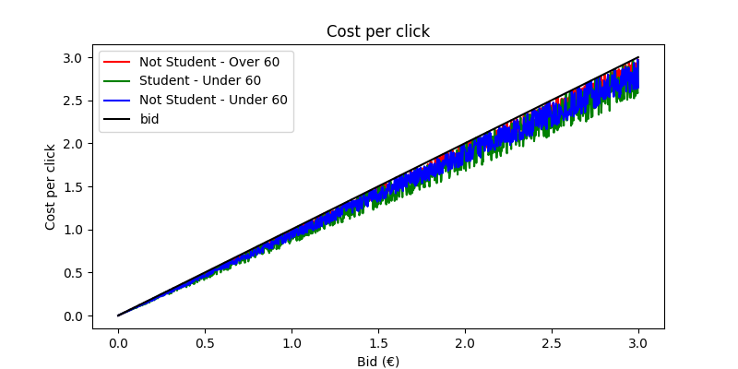
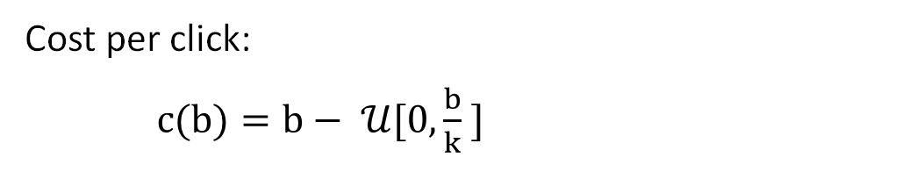
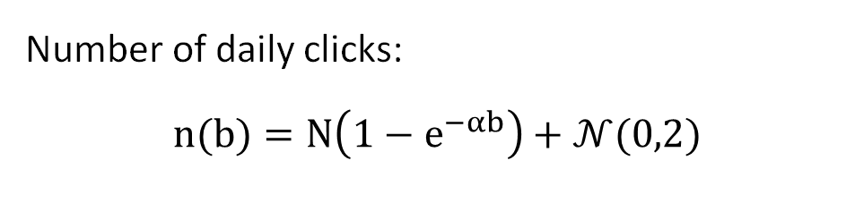
CONTEXT Description
Bid Related Parameters
Number of daily clicks:
$$n(b)=N\left(1−e^{−αb}\right)+𝒩(0,2)$$
Cost per click:
$c(b)=b− 𝒰[0,\frac{b}{k} ]$
Liguoro Claudio, Mapelli Alessia, Tonazzi Sara
POLITECNICO DI MILANO 1863
Notes:
The bidding related parameters linked to each customers class are number of daily click on the advertise, and so the number of new custmer, we expect each day as a function of the bid and the cost for each single click as a function of the bid. Both are defined as a function to which we add some noise and the graph represent one realization for each of the customers class: The parameters was defined specifically for each class so for example N will be highr for student but the slope will be lower and the k will also be lower given the great competition

Slide 6
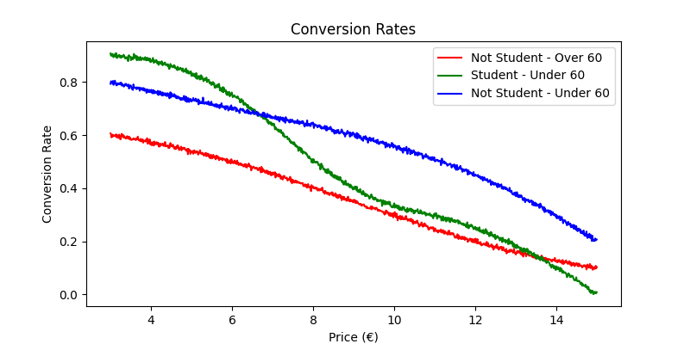
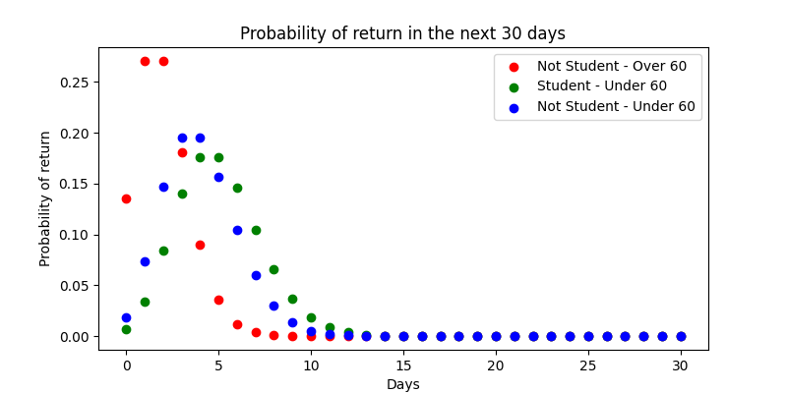
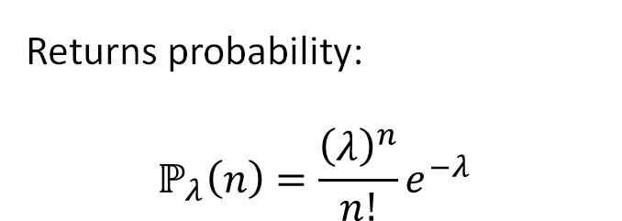
Context description
Price Related Parameters
Conversion rate:
Cubic interpolation of a noisy function in the prices [3, 6, 9, 12, 15]
Returns probability:
$$ℙ_{λ}\left(n\right)=\frac{{\left(λ\right)}^{n}}{n!}e^{−λ}$$
Liguoro Claudio, Mapelli Alessia, Tonazzi Sara
POLITECNICO DI MILANO 1863
Notes:
The pricing related parameters linked to each customers class are the conversion rate, so the probability that a user will buy the item, as a function of the price and the probability of returns that we defined as a possion with a mean specific for each customer class. The conversion rate was defined as a cubic interpolation of some specifc points to get more flexibility in the definition

Slide 7
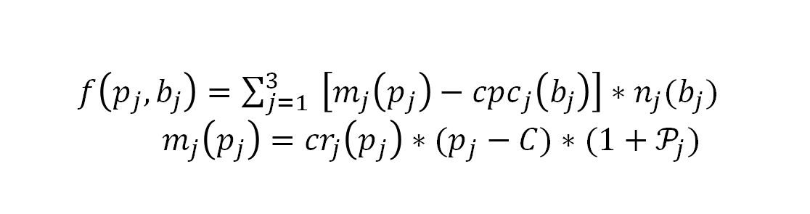
Problem Set Up
Objective Function Definition
Assumptions:
We consider one sub-campaign for each customers’ class
Time horizon is 365 days
The maximization is on the daily reward
$f\left(p_{j},b_{j}\right)=\sum_{j=1}^{3}{ \left[m_{j}\left(p_{j}\right)−{cpc}_{j}\left(b_{j}\right)\right]∗n_{j}(b_{j})}$ $m_{j}\left(p_{j}\right)={cr}_{j}\left(p_{j}\right)∗(p_{j}−C)∗(1+𝒫_{j})$
$𝔼\left[\max_{p_{j}, b_{j}}{\sum_{j=1}^{N}{ \left[m_{j}\left(p_{j}\right)−{cpc}_{j}\left(b_{j}\right)\right]∗n_{j}(b_{j})}}\right]=\max_{p_{j}, b_{j}}{\sum_{j=1}^{N}{ \left[𝔼\left[m_{j}\left(p_{j}\right)\right]−𝔼\left[{cpc}_{j}\left(b_{j}\right)\right]\right]∗𝔼\left[n_{j}(b_{j})\right]}}$
Liguoro Claudio, Mapelli Alessia, Tonazzi Sara
POLITECNICO DI MILANO 1863
Notes:
Now we need to set up the optimization problem we wanna solve. We based the optimization on the daily reward. In particualr consideting one sub-campain for each customers’ class each day we can maxime the reward preduced by each of them. For each campain the reward is defined as the number of clicks multipled by the margin of each clink minus the cost per click. The maring is characterized by the conversion reate and takes into accpunt the returns by summing them to the first purchase. In defining this problem we simplify the advertisiment model; indeed, we imagine having an unlimited budget and we do not include in the problem the auction mechanism typical of the advertisement scenario, another semplification is in the cost per item, we imagine to have a fixed cost per item independent on the qauntity sold . Moreocer The optimization problem is stocastic so we want to try and maximize the mean value of the objective funcion.

Slide 8
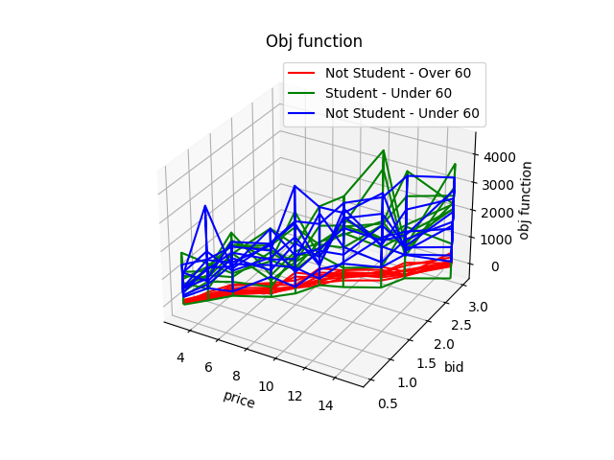
Problem Set Up
Optimization with known parameters
$𝔼\left[\max_{p_{j}, b_{j}}{\sum_{j=1}^{N}{ \left[m_{j}\left(p_{j}\right)−{cpc}_{j}\left(b_{j}\right)\right]∗n_{j}(b_{j})}}\right]=\max_{p_{j}, b_{j}}{\sum_{j=1}^{N}{ \left[𝔼\left[m_{j}\left(p_{j}\right)\right]−𝔼\left[{cpc}_{j}\left(b_{j}\right)\right]\right]∗𝔼\left[n_{j}(b_{j})\right]}}$
Discretization:
Prices: [3, 4, 5, 7, 8, 9, 10 ,12, 13, 15 ]
Bids: [0.5, 0.75, 1, 1.25, 1.5, 1.75, 2, 2.25, 2.5, 3]
Grid search algorithm with complexity:
O(3 × N_{p} × N_{b})
O(3 × N_{p} × N_{b})
Liguoro Claudio, Mapelli Alessia, Tonazzi Sara
POLITECNICO DI MILANO 1863
Notes:
We suppose that every parameter is known in the beginning to find a general mathematical optima to the problem. Thinking about p and b to be positive real variables, solving this problem theoretically it’s a challenge. The objective function is not convex, could present several local minima and it cannot be disaggregated in two different optimizations for the pricing and advertising. in a real case scenario we usually discretize the prices and bids between which we can choose the best one. Usually not many values are considered since the budget spendable in each campaign is limited and the prices are considered in the range of the competitors. We have discretised our prices and bids in the 10 value each and we can then perform a grid search algorithm to fond the optima. The algorithm complexity get high and highr as the discretization gets precise

Slide 9







Problem Set Up
Optimization solutions with known parameters
Over 60
Price: 9
Bid: 2
Students
Price: 7
Objective function: 2884.92
Under 60 not students
Objective function: 262.64
Bid: 3
Price: 10
Bid: 3
Objective function: 2775.75
Aggregated
Price: 8
Bid: 3
Objective function: 5291.22
Total objective function value: 5923,31
Liguoro Claudio, Mapelli Alessia, Tonazzi Sara
POLITECNICO DI MILANO 1863
Notes:
We obtain the results present in the slide and in particular we evaluated the optimlal bidding and pricing strategy for the three separate classes and the aggregated case in which we evaluate all the classes together and we are not able to differenciate the prices and the advertising investment. Note that the disagreggated strategy get a higher objective function then the one of the aggregated cae . This is usually true and this lead us to the implementation of an algorithm to retrive the best partition of the customers to differenciate prices

Slide 10
Problem Set Up
Modeling of the Unknown Parameters
Daily Number of clicks: $n_{b}\text{ \sim }\text{N}\text{(}\text{n}\text{(}\text{b}\text{), }σ^{2}\text{)}$
Daily Number of clicks: 𝑛_𝑏 " ~ N(n(b), " 𝜎^2 ")"
Daily cost per click: ${cpc}_{b}\text{\sim }\text{N}\text{(}\text{c}\text{(}\text{b}\text{), }σ^{2}\text{) }$
Daily cost per click: 〖𝑐𝑝𝑐〗_𝑏 "~N(c(b), " 𝜎^2 ") "
Conversion rate: $cr\left(p\right) \sim Be({ c}_{rate}\left(p\right) )$
Conversion rate: 𝑐𝑟(𝑝) ~ 𝐵𝑒(〖 𝑐〗_𝑟𝑎𝑡𝑒 (𝑝) )
Probability of comebacks: $𝒫_{j}(p) \sim Po($ $λ)$
Probability of comebacks: 𝒫_𝑗 (𝑝) ~ 𝑃𝑜( 𝜆)
Delay feedbacks in the comeback
Liguoro Claudio, Mapelli Alessia, Tonazzi Sara
POLITECNICO DI MILANO 1863
Notes:
In a real case senario, all the customer specific parameters are unknown. Considering each parameter as a random variable we can hypothesize their distribution. We suppose the conversion rate related to each price to be distributed as a Bernoulli with an unknown expected value 𝑐𝑟𝑎𝑡𝑒(𝑝) that represent the probability of purchase of a custumer given the specific price for the item. Then we suppose that the probability distribution over the number of times the user will come back to the e-commerce website is a Poisson distribution with an unknown expected value. Finally we suppose that the cost per click and the number of clicks are distributed normally with mean equal to the unknown true value of the function and variance that represent the error with which the data are measured. We need to consider, in our scenario, the delay feedback we receive due to the user’s comeback. We imagine being able to evaluate this parameter only after 30 days from each user’s first purchase, so that we receive incomplete information every day and we retrieve the missing part only after 30 days .

Slide 11
Problem Set Up
Bid learner pull the bid
$$b_{t}$$
𝒃_𝒕
Bid environment returns bid associated quantites
$b_{t}$, $p_{t}$
𝒃_𝒕, 𝒑_𝒕
Price Learner pull the price
$p_{t} ,n_{b,t}$, ${cpc}_{b,t}$
𝒑_𝒕 ,𝒏_(𝒃,𝒕) , 〖𝒄𝒑𝒄〗_(𝒃,𝒕)
Pricing environment returns price associated quantities
$n_{returns}\left(t\right)$, $n_{purcahse}(t)$ , $n_{b,t}$, ${cpc}_{b,t}$ , $p_{t}$
𝒏_𝒓𝒆𝒕𝒖𝒓𝒏𝒔 (𝒕), 𝒏_𝒑𝒖𝒓𝒄𝒂𝒉𝒔𝒆 (𝒕) , 𝒏_(𝒃,𝒕) , 〖𝒄𝒑𝒄〗_(𝒃,𝒕) , 𝒑_𝒕
Evaluation of the daily objective function
$n_{returns}\left(t\right)$, $n_{purcahse}(t)$ , $n_{b,t}$, ${cpc}_{b,t}$ , $p_{t}$
𝒏_𝒓𝒆𝒕𝒖𝒓𝒏𝒔 (𝒕), 𝒏_𝒑𝒖𝒓𝒄𝒂𝒉𝒔𝒆 (𝒕) , 𝒏_(𝒃,𝒕) , 〖𝒄𝒑𝒄〗_(𝒃,𝒕) , 𝒑_𝒕
Bid learner update the value of the parameters
$n_{returns}\left(t\right)$, $n_{purcahse}(t)$ , $n_{b,t}$, ${cpc}_{b,t}$ , $p_{t}$
𝒏_𝒓𝒆𝒕𝒖𝒓𝒏𝒔 (𝒕), 𝒏_𝒑𝒖𝒓𝒄𝒂𝒉𝒔𝒆 (𝒕) , 𝒏_(𝒃,𝒕) , 〖𝒄𝒑𝒄〗_(𝒃,𝒕) , 𝒑_𝒕
Pricing learner update the value of the parameters
$$m_{t}$$
𝒎_𝑡
Sketch of the solution
Liguoro Claudio, Mapelli Alessia, Tonazzi Sara
POLITECNICO DI MILANO 1863
Notes:
The algorithm we propose assumes that, once chosen b and p, we receive feedback from customers thanks to which we can update and improve our estimation of the parameters. We suppose that each round is a full day. At the star of each day we extract the daily bid that maximize the objective function evluated basing on the registerd number of clicks and cost per click and margin based on the pricing paramters of the previuos day. We pull also the price that maximize the margin per click based on the registered conversion rates and returns. At the end of the day, given the selected bid and price, we recieve a feedback on the number of clicks and the cost per click collected that day and on the number of purchase and the number of returns collected from which we can evluate the daily reward . Once we have all the feedback we can update both the paramters linked to the pricing optimization and to the bid optimization and start another iteration.

Slide 12
TS
UCB1
PRICING STRATEGY
Notes:
Now I show you our approach in solving the pricing optimization problem. In this section we will find the best price strategy: without distinguish in the users class first and with a context generation then. In both the analysis we will study the performances of two bandit algorithms that are upper confidence bound and thompson sampling

Slide 13
PRICING - aggregated OPTIMIZATION
learner.pull_arm
reward = env.round(classes)
learner.update(reward)
Pseudo-code of a single day of the experiment
Liguoro Claudio, Mapelli Alessia, Tonazzi Sara
POLITECNICO DI MILANO 1863
Notes:
This is the structure of our pricing optimization problem without differentiating in the customers classes. For every day of the 50 experiments performed we do this 3 steps.

Slide 14
PRICING - aggregated OPTIMIZATION
learner.pull_arm
reward = env.round(classes)
learner.update(reward)
Pseudo-code of a single day of the experiment
if t<n_arms:
pulled_arm = t
else:
for a in range(n_arms):
value[a] = margin(a, upper_bound/beta)
pulled_arm = where(value == value.max)
return pulled_arm
learner.pull_arm
Liguoro Claudio, Mapelli Alessia, Tonazzi Sara
POLITECNICO DI MILANO 1863
Notes:
First of all we pull an arm from the learner, in a classic way except for value that we choose to maximize. Indeed we can’t choose the arm which maximize only the conversion rate, because in our problem there are the returns too that don’t depends directly on the price, but they depends on the conversion rate because more people do the purchase, more return we may have

Slide 15
PRICING - aggregated OPTIMIZATION
learner.pull_arm
reward = env.round(classes)
learner.update(reward)
Pseudo-code of a single day of the experiment
for class in classes:
n_clicks(bid)
cost_per_click(bid)
n_purchases = binomial(cr, n_clicks)
past_purchases[class].append(n_purchases)
past_arms[class].append(pulled_arm)
obj = #without returns
if t > 29:
returns = poisson(lambda, past_purchases[t-30])
obj = #with returns
obj_vector.append(obj)
return sum(obj)
env.round
Liguoro Claudio, Mapelli Alessia, Tonazzi Sara
POLITECNICO DI MILANO 1863
Notes:
In a second step we call the round function of the environment, that works in a more particular way. There is a for cycle that selects one type of customer at a time and extracts the parameters (such as number of clicks and cost per click) from the functions defined before that are specific for each customer. We calculate the objective function of the customer selected and, If we are after the twenty nineth day, we consider the returns too. Indeed we have a delay of 30 days in the feedback of the returns as said before.
At the end of the for cycle we sum the three objective function calculated for each type of customer and we return this sum as the daily objective function. In this way we can weight the objective function without knowing a priori the composition of our audience. indeed we didn’t want to set a percentage with which each type of costumer will come on our platform but we wanted to learn it during the experiments.

Slide 16
PRICING - aggregated OPTIMIZATION
learner.pull_arm
reward = env.round(classes)
learner.update(reward)
Pseudo-code of a single day of the experiment
#update all the parameters
if t > 29:
#update lamda_poisson
learner.update
Liguoro Claudio, Mapelli Alessia, Tonazzi Sara
POLITECNICO DI MILANO 1863
Notes:
The last step is an update of the learner parameters, which include the update of the poisson mean if the time is greater than 29

Slide 17
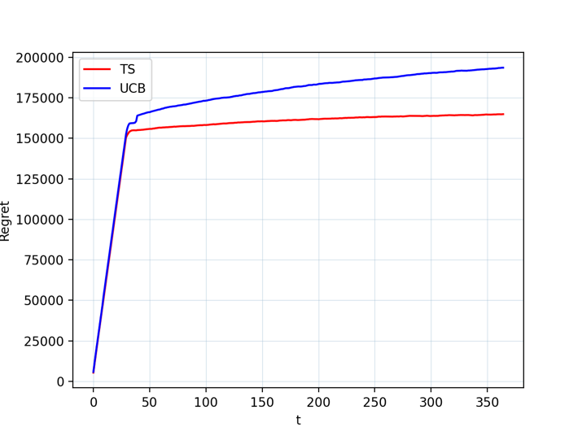
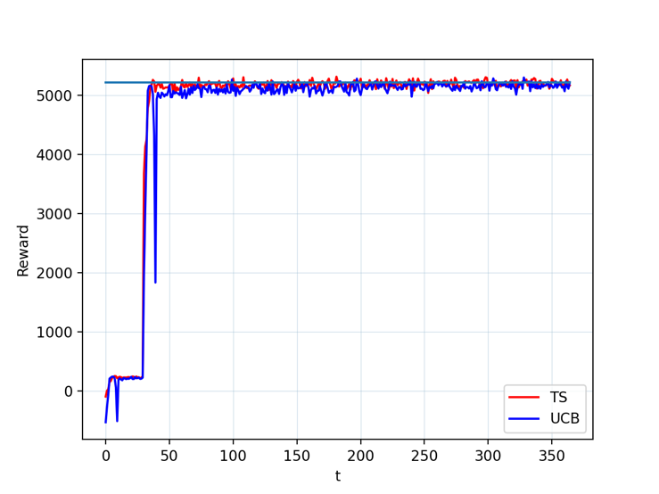
PRICING
Fixed bid = 3
Best price = 8
Aggregated optimization problem
Liguoro Claudio, Mapelli Alessia, Tonazzi Sara
POLITECNICO DI MILANO 1863
Notes:
Theese are the results of our optimization problem with upper confidence bound in blue and thompson sampling in red. We can see that both ucb and ts rewards grow towards the optimal value quite fast, with ucb that takes some rounds more to get to convergence. There is a great evidence in the change of the regrete and of the reward after 30 days, that is the point in time from whic we start to consider the returns.

Slide 18
Pricing - context generation
Pseudo-code of a single experiment
for t in range(365):
for context in contexts:
for class in context:
learner[class].pull_arm
for user in class:
reward += env[context].round
learner[class].update(reward)
if t % 14 == 0 and split != 2:
# check condition
if check.condition == true
# split
FIRST STAGE – Users aggregated
Liguoro Claudio, Mapelli Alessia, Tonazzi Sara
POLITECNICO DI MILANO 1863
Notes:
Now we do the same analysis of before but with a context generation and so we want to discover which types of user we need to apply different pricing strategies to.
The pseudo code isn’t so easy so I illustrate the different steps of it.

Slide 19
Pricing - context generation
Pseudo-code of a single experiment
for t in range(365):
for context in contexts:
for class in context:
learner[class].pull_arm
for user in class:
reward += env[context].round
learner[class].update(reward)
if t % 14 == 0 and split != 2:
# check condition
if check.condition == true
# split
FIRST STAGE – Users aggregated
contexts
current
alternative 1
alternative 2
alternative 3
Liguoro Claudio, Mapelli Alessia, Tonazzi Sara
POLITECNICO DI MILANO 1863
Notes:
In the first stage of the context generation we have the users all aggregated in one class and we evaluate the alternatives in which we split one types of user from the others.
We construct an array called contexts containing the current context and the alternative ones. Every context has is own environment.
The for cycle after the first for the days, selects this contexts one at a time, in this way:

Slide 20
context generation
Pseudo-code of a single experiment
for t in range(365):
for context in contexts:
for class in context:
learner[class].pull_arm
for user in class:
reward += env[context].round
learner[class].update(reward)
if t % 14 == 0 and split != 2:
# check condition
If check.condition == true
# split
FIRST STAGE – Users aggregated
contexts
current
alternative 1
alternative 2
alternative 3
Liguoro Claudio, Mapelli Alessia, Tonazzi Sara
POLITECNICO DI MILANO 1863
Notes:
The current one

Slide 21
context generation
Pseudo-code of a single experiment
for t in range(365):
for context in contexts:
for class in context:
learner[class].pull_arm
for user in class:
reward += env[context].round
learner[class].update(reward)
if t % 14 == 0 and split != 2:
# check condition
If check.condition == true
# split
FIRST STAGE – Users aggregated
contexts
current
alternative 1
alternative 2
alternative 3
Liguoro Claudio, Mapelli Alessia, Tonazzi Sara
POLITECNICO DI MILANO 1863
Notes:
And the alternative ones

Slide 22
context generation
Pseudo-code of a single experiment
for t in range(365):
for context in contexts:
for class in context:
learner[class].pull_arm
for user in class:
reward += env[context].round
learner[class].update(reward)
if t % 14 == 0 and split != 2:
# check condition
If check.condition == true
# split
FIRST STAGE – Users aggregated
contexts
current
alternative 1
alternative 2
alternative 3
Liguoro Claudio, Mapelli Alessia, Tonazzi Sara
POLITECNICO DI MILANO 1863

Slide 23
context generation
Pseudo-code of a single experiment
for t in range(365):
for context in contexts:
for class in context:
learner[class].pull_arm
for user in class:
reward += env[context].round
learner[class].update(reward)
if t % 14 == 0 and split != 2:
# check condition
If check.condition == true
# split
FIRST STAGE – Users aggregated
contexts
current
alternative 1
alternative 2
alternative 3
Liguoro Claudio, Mapelli Alessia, Tonazzi Sara
POLITECNICO DI MILANO 1863

Slide 24
context generation
Pseudo-code of a single experiment
for t in range(365):
for context in contexts:
for class in context:
learner[class].pull_arm
for user in class:
reward += env[context].round
learner[class].update(reward)
if t % 14 == 0 and split != 2:
# check condition
If check.condition == true
# split
FIRST STAGE – Users aggregated
contexts
current
alternative 1
alternative 2
alternative 3
Liguoro Claudio, Mapelli Alessia, Tonazzi Sara
POLITECNICO DI MILANO 1863
Notes:
The for cycle inside selects every class in the selected context. So for the current context we have only one class but for example for the second context we have two classes:

Slide 25
context generation
Pseudo-code of a single experiment
for t in range(365):
for context in contexts:
for class in context:
learner[class].pull_arm
for user in class:
reward += env[context].round
learner[class].update(reward)
if t % 14 == 0 and split != 2:
# check condition
If check.condition == true
# split
FIRST STAGE – Users aggregated
contexts
current
alternative 1
alternative 2
alternative 3
Liguoro Claudio, Mapelli Alessia, Tonazzi Sara
POLITECNICO DI MILANO 1863

Slide 26
context generation
Pseudo-code of a single experiment
for t in range(365):
for context in contexts:
for class in context:
learner[class].pull_arm
for user in class:
reward += env[context].round
learner[class].update(reward)
if t % 14 == 0 and split != 2:
# check condition
If check.condition == true
# split
FIRST STAGE – Users aggregated
contexts
current
alternative 1
alternative 2
alternative 3
Liguoro Claudio, Mapelli Alessia, Tonazzi Sara
POLITECNICO DI MILANO 1863
Notes:
For every class we have a different learner. After have pulled the arm we do a for cycle to select one type of user per time, so for example in the selected class we have two types of users

Slide 27
context generation
Pseudo-code of a single experiment
for t in range(365):
for context in contexts:
for class in context:
learner[class].pull_arm
for user in class:
reward += env[context].round
learner[class].update(reward)
if t % 14 == 0 and split != 2:
# check condition
If check.condition == true
# split
FIRST STAGE – Users aggregated
contexts
current
alternative 1
alternative 2
alternative 3
Liguoro Claudio, Mapelli Alessia, Tonazzi Sara
POLITECNICO DI MILANO 1863

Slide 28
context generation
Pseudo-code of a single experiment
for t in range(365):
for context in contexts:
for class in context:
learner[class].pull_arm
for user in class:
reward += env[context].round
learner[class].update(reward)
if t % 14 == 0 and split != 2:
# check condition
If check.condition == true
# split
FIRST STAGE – Users aggregated
contexts
current
alternative 1
alternative 2
alternative 3
Liguoro Claudio, Mapelli Alessia, Tonazzi Sara
POLITECNICO DI MILANO 1863
Notes:
For every type of user we call the round function and we sum the obtained reward for every users in the class. Then we give the summed reward at the function update of the learner of the class.
After this is if we are in a time multiple of 14, and so every two weeks, we evaluate if is better to split or not.
In our case we split in a certain time to the alternative 3 and we update the context array in this way.

Slide 29
PRICING – context generation
Pseudo-code of a single experiment
for t in range(365):
for context in contexts:
for class in context:
learner[class].pull_arm
for user in class:
reward += env[context].round
learner[class].update(reward)
if t % 14 == 0 and split != 2:
# check condition
If check.condition == true
# split
SECOND STAGE – Splitted one time
contexts
current
alternative
Liguoro Claudio, Mapelli Alessia, Tonazzi Sara
POLITECNICO DI MILANO 1863
Notes:
The alternative 3 becomes the current context and the only alternative that we consider is the one with all the types of users disaggregated.

Slide 30
PRICING – context generation
Pseudo-code of a single experiment
for t in range(365):
for context in contexts:
for class in context:
learner[class].pull_arm
for user in class:
reward += env[context].round
learner[class].update(reward)
if t % 14 == 0 and split != 2:
# check condition
If check.condition == true
# split
THIRD STAGE – Splitted two times
contexts
current
Liguoro Claudio, Mapelli Alessia, Tonazzi Sara
POLITECNICO DI MILANO 1863
Notes:
When we split again the only context considered is the current one and we don’t check anymore the split condition

Slide 31
PRICING – context generation
Split timeline
T=0
Aggregated
T=20-30
First split
T=70-100
Second split
T=365
End of the experiment
Liguoro Claudio, Mapelli Alessia, Tonazzi Sara
POLITECNICO DI MILANO 1863
Notes:
In our scenario the splits happen quite soon: the first one with the under 60 not student alone and student and over 60 togheter happens after 20-30 days from the beginning and the second split after 50-60 days from the first

Slide 32
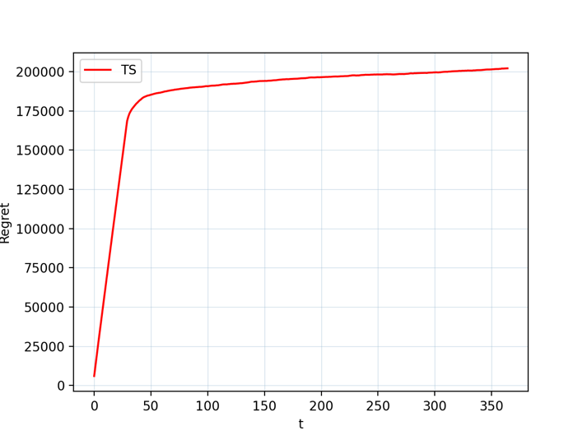
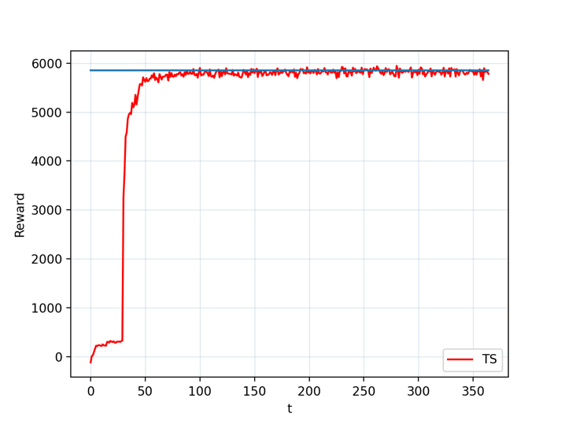
PRICING – context generation
Fixed bid = 3
Best price = 9
Fixed bid = 3
Best price = 7
Optimization problem with context generation
Fixed bid = 3
Best price = 10
Split 1
Split 2
Liguoro Claudio, Mapelli Alessia, Tonazzi Sara
POLITECNICO DI MILANO 1863
Notes:
We represent here the tompson sampling regret and reward for the pricing optimization problem with context generation. As we can see we reach the optimum quite fast, with a little improvement near the splits

Slide 33
GTS
ADVERTISING STRATEGY
Notes:
Now we focus on the other requireiment of the problem: finding the best advertising strategy. Our solution to the problem involves again an Online Learning approach: in this case we adopted a Gaussian Thomas Sampling ​algo. Before looking at its details let's take a general view of the problem settings and assumptions.

Slide 34
BIDDING – aggregated optimization
Advertising strategy introduction
Assumptions:
Environment
Fixed price
No auction
Unlimited budget
bid
daily revenue,
number of clicks, cost per click
Learner
Liguoro Claudio, Mapelli Alessia, Tonazzi Sara
POLITECNICO DI MILANO 1863
Notes:
So this is the big picture of the problem setting and solution: on the left we see the assumptions we made: so no auction, unlimited badge, and at least in this phase we use a fixed price.
Again, the components involved are the Learner that plays a bid at each round, and an Environment that gives a revenew to the Learner.

Slide 35
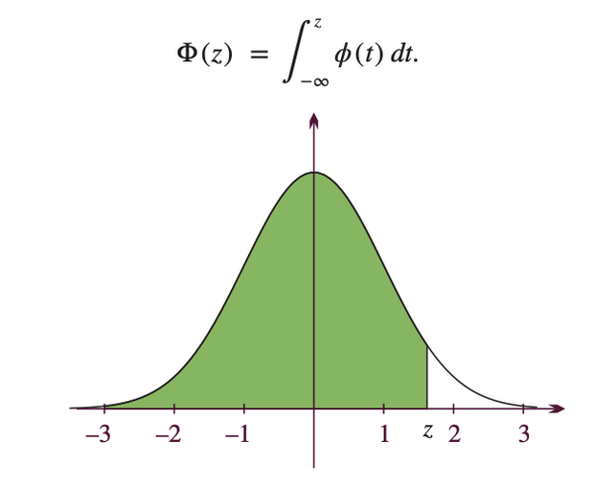
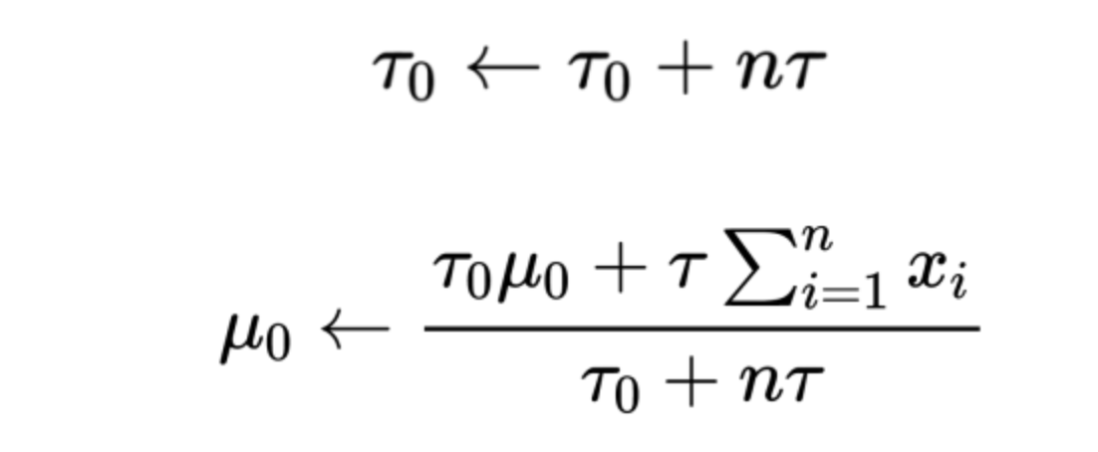
BIDDING – aggregated optimization
Algorithm specifics
SAFETY CONSTRAINT:
Before pulling ”best” empirical arm we evaluate the probability of giving a negative reward (for each arm) with CDF(0)
GAUSSIAN THOMPOS SAMPLING
Updating formulas
Liguoro Claudio, Mapelli Alessia, Tonazzi Sara
POLITECNICO DI MILANO 1863
Notes:
The only difference to the Algorithm seen during the presentation of the pricing problem is relative to the underline distribution. The logic of the algorithm is the same as described for the TS for pricing, but here the prior and posterior distribution need to take into account that we are dealing with a continus random variable. So we model the output using a normal distribution and gradually refine this model by updating its mean and variance parameters. If, instead of using the variance, we use the precision ‘τ’ (tau), where precision is just one over the variance (precision τ = 1/variance), then we can use the simple update rules for the mean ‘μ₀’ and total precision ‘τ₀’
where;
‘τ’ is the precision
’n’ is the number of times the arm has been pulled.
‘xᵢ’ is the output received at each pull of arm i
‘μ₀’ is the estimated mean (the mean of the distribution used to model the output).
‘τ₀’ is the total precision of the distribution .
Moreover in this scenario we need to apply a safety constraint to avoid playing bid that gives negative rewards. For this requirement, we adopted a probabilistic approach, and in particular we used the cumulative distribution function to estimate the probability that a given bid gives negative reward. If this probabilty is higher than a given threshold than we do not consider that arm in the daily pulling process.

Slide 36
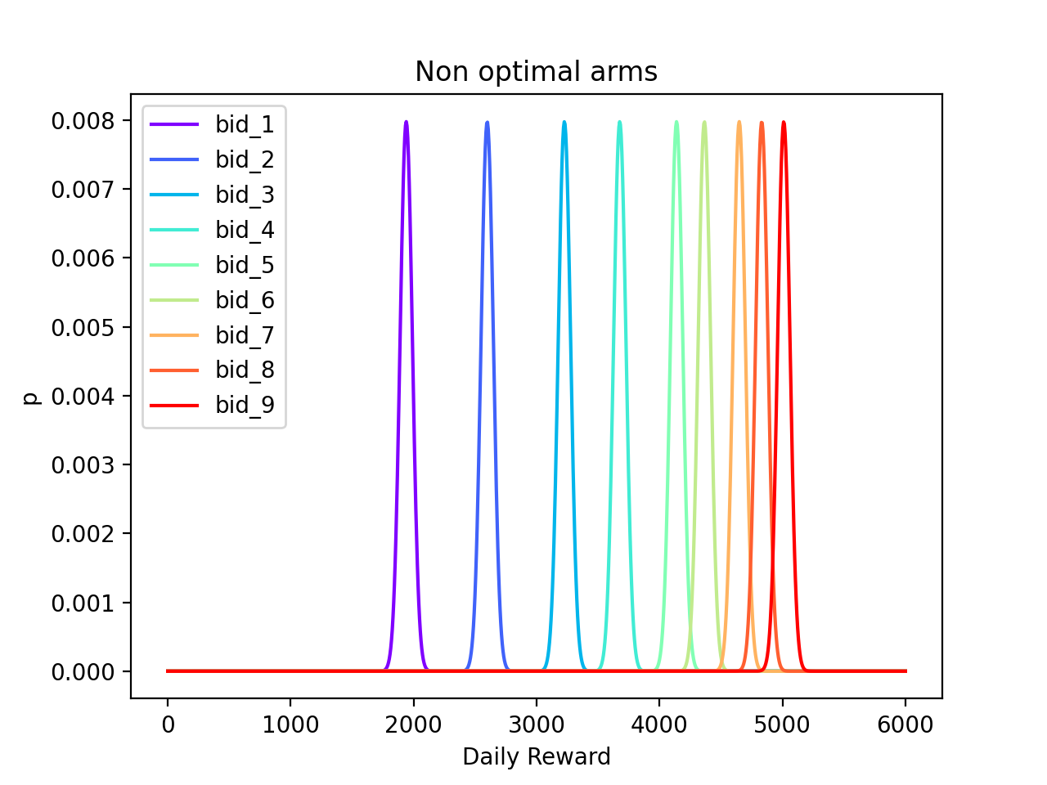
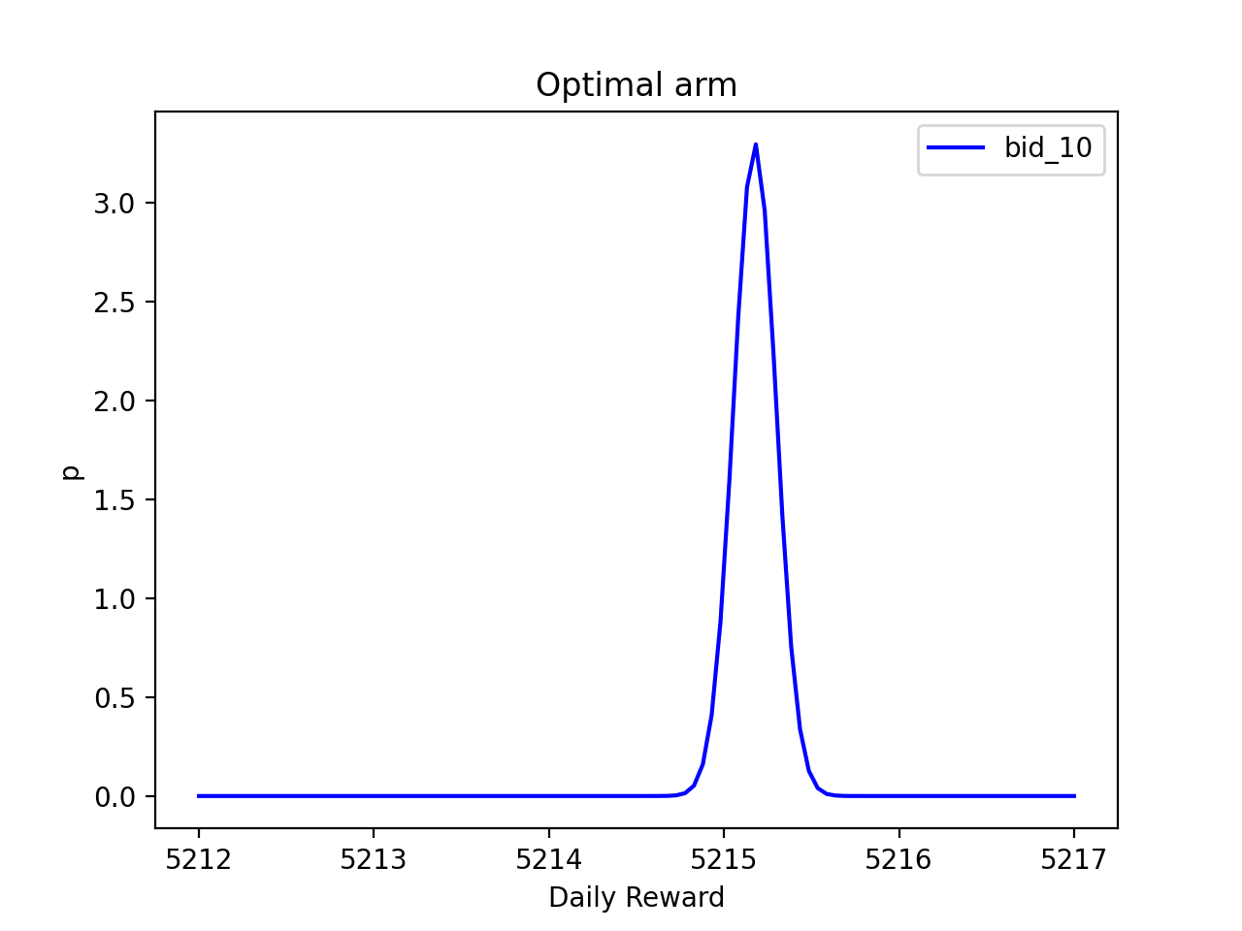
BIDDING – aggregated optimization
Problem results
GAUSSIAN THOMAS SAMPLING
Liguoro Claudio, Mapelli Alessia, Tonazzi Sara
POLITECNICO DI MILANO 1863
Notes:
At the end of the learning process we will obtain a list of gaussian distribution for each bid. The plots tell that non optimal arm have lower mean wrt to the optimal one. This causes, during each experiment, to sample a value that is greater than the others (the one you would pull choosing a non optimal arm) and so at the end of the experiment, after a certain period of exploration, the Learner exploits the best empirical arm that luckily, in this case, coincide with the optimal one.

Slide 37
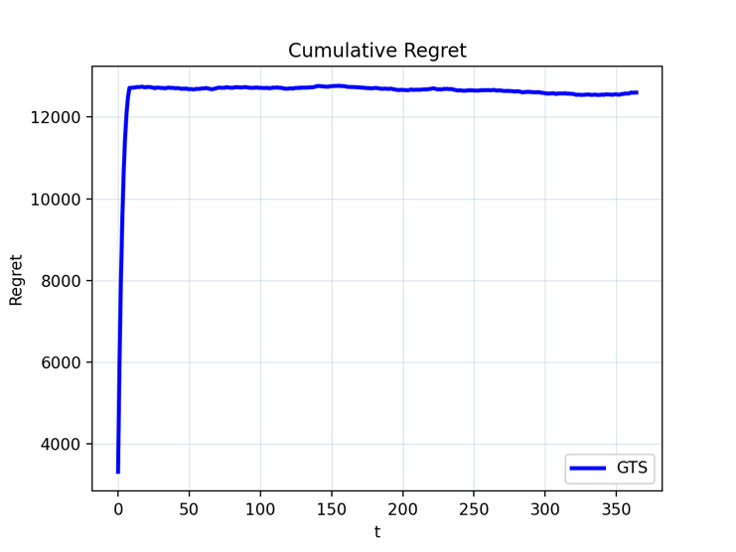
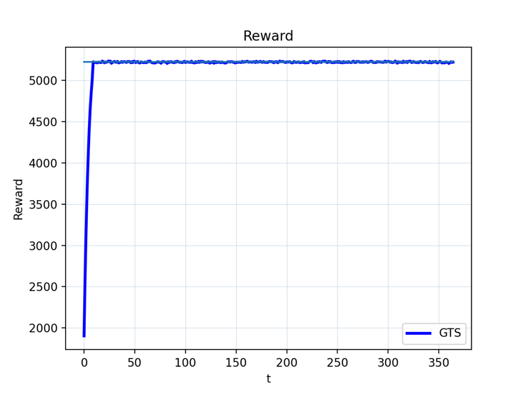
BIDDING
Fixed price = 8
Best bid = 3
Aggregated optimization problem results
Liguoro Claudio, Mapelli Alessia, Tonazzi Sara
POLITECNICO DI MILANO 1863
Notes:
From a regret/reward point of view, we can take a look to the following plots: on the left we have the behavior of the regret (wrt to the clairvoyant algorithm) and on the right we have the reward per day. As we can see, after a small amount of time, the learner is capable of doing the best choice and choosing the optimal arm.

Slide 38
GTS
TS
Pricing & ADVERTISING
STRATEGY
Notes:
Once we have analyzed each single part of both the pricing and bidding strategy we present and analyze the algorithm to perform the simultaneous optimization of the two strategies. Starting from what we have implemented so far, we will follow the algorithm developed in the theoretical resolution of the problem.

Slide 39
PRICING AND BIDDING - aggregated
Pseudo-code of a single experiment
for t in range(365):
bid_arm = bid_learner.pull_arm(price_arm, price_reward)
bid_reward = env.round_bid(bid_arm)
price_arm = price_learner.pull_arm(t)
price_reward = env.round_price(bid_arm, price_arm, bid_reward, t)
bid_learner.update(bid_arm, bid_reward)
price_learner.update(price_arm, price_reward, bid_reward)
The Algorithm
Conversion Rate, N returns
bid
ENVIRONMENT
price
PRICING LEARNER
BIDDING LEARNER
N clicks, CPC
Liguoro Claudio, Mapelli Alessia, Tonazzi Sara
POLITECNICO DI MILANO 1863
Notes:
At first we will work on the aggregated scenario, without any distinction in both pricing and advertising between the customers’ classes. The algotithm is outlined in the peeudocode. We defined two learner one related to pricing and one to bidding and one enviroments that is a merge of the two related to different problems. For each day we pull a bid following the TS algotirhm with the maximization of the objective function. In this case the bid learner focus on learning both the number of click and the cost per click instead of the whole objective function. This is the solution found to avoid excessive corretaion between price and bid selection. Note also that the pricing paramters of the objective funcrion are the one of the previous round

Slide 40
PRICING AND BIDDING - aggregated
Pseudo-code of a single experiment
for t in range(365):
bid_arm = bid_learner.pull_arm(price_arm, price_reward)
bid_reward = env.round_bid(bid_arm)
price_arm = price_learner.pull_arm(t)
price_reward = env.round_price(bid_arm, price_arm, bid_reward, t)
bid_learner.update(bid_arm, bid_reward)
price_learner.update(price_arm, price_reward, bid_reward)
The Algorithm
Conversion Rate, N returns
bid
ENVIRONMENT
price
PRICING LEARNER
BIDDING LEARNER
N clicks, CPC
Liguoro Claudio, Mapelli Alessia, Tonazzi Sara
POLITECNICO DI MILANO 1863
Notes:
Given the bid the environment will return the values of number of clicks and cost per click collected drawng from the distribution of each parameter

Slide 41
PRICING AND BIDDING - aggregated
Pseudo-code of a single experiment
for t in range(365):
bid_arm = bid_learner.pull_arm(price_arm, price_reward)
bid_reward = env.round_bid(bid_arm)
price_arm = price_learner.pull_arm(t)
price_reward = env.round_price(bid_arm, price_arm, bid_reward, t)
bid_learner.update(bid_arm, bid_reward)
price_learner.update(price_arm, price_reward, bid_reward)
The Algorithm
Conversion Rate, N returns
bid
ENVIRONMENT
price
PRICING LEARNER
BIDDING LEARNER
N clicks, CPC
Liguoro Claudio, Mapelli Alessia, Tonazzi Sara
POLITECNICO DI MILANO 1863
Notes:
Then we pull the best price also in this case following TS algorithm and maximizine the margin.

Slide 42
PRICING AND BIDDING - aggregated
Pseudo-code of a single experiment
for t in range(365):
bid_arm = bid_learner.pull_arm(price_arm, price_reward)
bid_reward = env.round_bid(bid_arm)
price_arm = price_learner.pull_arm(t)
price_reward = env.round_price(bid_arm, price_arm, bid_reward, t)
bid_learner.update(bid_arm, bid_reward)
price_learner.update(price_arm, price_reward, bid_reward)
The Algorithm
Conversion Rate, N returns
bid
ENVIRONMENT
price
PRICING LEARNER
BIDDING LEARNER
N clicks, CPC
Liguoro Claudio, Mapelli Alessia, Tonazzi Sara
POLITECNICO DI MILANO 1863
Notes:
And given the price the environemnt will return the number of purchase and the number of returns related to purchase happend 30 days ago. In this pahse we also evaluate the daiyly reward obtained that will then be compared with the one from the clyrvoian algorithm to asses the performance of the algorithm

Slide 43
PRICING AND BIDDING - aggregated
Pseudo-code of a single experiment
for t in range(365):
bid_arm = bid_learner.pull_arm(price_arm, price_reward)
bid_reward = env.round_bid(bid_arm)
price_arm = price_learner.pull_arm(t)
price_reward = env.round_price(bid_arm, price_arm, bid_reward, t)
bid_learner.update(bid_arm, bid_reward)
price_learner.update(price_arm, price_reward, bid_reward)
The Algorithm
Conversion Rate, N returns
bid
ENVIRONMENT
price
PRICING LEARNER
BIDDING LEARNER
N clicks, CPC
Liguoro Claudio, Mapelli Alessia, Tonazzi Sara
POLITECNICO DI MILANO 1863
Notes:
Finally both the parameters from pricing and bidding are updated as explained in the previos steps

Slide 44
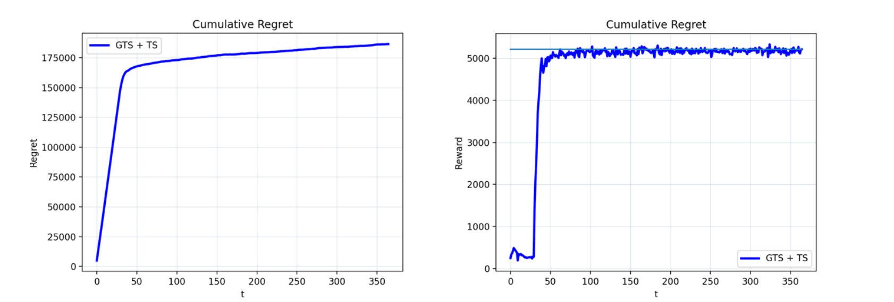
PRICING AND BIDDING - aggregated
Optimization problem for the disaggregated case
Fixed price = 8
Best bid = 3
Liguoro Claudio, Mapelli Alessia, Tonazzi Sara
POLITECNICO DI MILANO 1863
Notes:
The performance of this algorithm is pretty good, we have a high regret in particular in the first phase of the algorithm due to the absence of the evaluation of returns. The algorithm tough get to convergance and it’a able to identify correctly the best advertising and pricing strategy to exploit

Slide 45
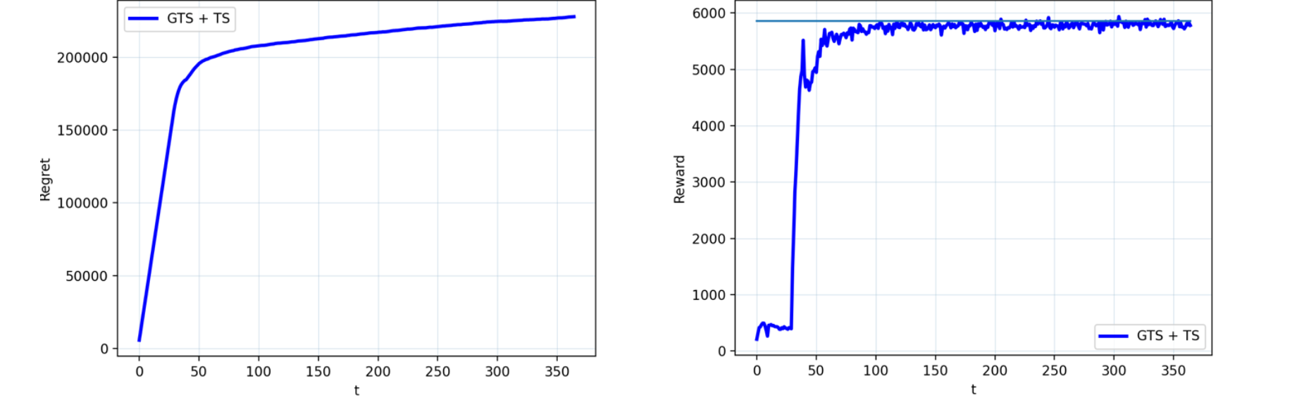
PRICING AND BIDDING - disaggregated
Fixed bid = 2
Best price = 9
Fixed bid = 3
Best price = 7
Optimization problem for the disaggregated case
Fixed bid = 3
Best price = 10
Liguoro Claudio, Mapelli Alessia, Tonazzi Sara
POLITECNICO DI MILANO 1863
Notes:
The last step is then to evaluate the algorithm on the context discovered with the context generation algorithm. The logic will be the same as in the aggregated case, we will just define the environment, the pricing and bidding learner for each class separately. We can then sum the daily objective function of each of them to evaluate the
performance of the algorithm. The performance is pretty similar to the one just discussed the convergence though is slower impling a higher regret

Slide 46
Conclusions
Price and Bid simultaneous optimization
Pricing Optimization
+
Bid Optimization
+
Context Generation
Price and Bid simultaneous optimization in a disaggregated way
Liguoro Claudio, Mapelli Alessia, Tonazzi Sara
POLITECNICO DI MILANO 1863
Notes:
To summaries our work we started from the simpler optimization of the separate bidding and pricing optimization and we aggregate them together to find a general algorithm able to solve the optimization problem required. On the other hand we implemented an algorithm able to discover the best partition of customers on which apply price differentaition getting to an increase revenue. The performance of our algorithms are preatty good and we are confident that this approach can be generalized to more complex and real case senarios.

Slide 47
THANK YOU FOR THE ATTENTION
Claudio Liguoro
Alessia Mapelli
Sara Tonazzi

